Slide 1
Tax and Digitalisation
Andrew Auerbach, Senior Tax Adviser
Centre for Tax Policy and Administration
OECD Jakarta Office

Slide 2
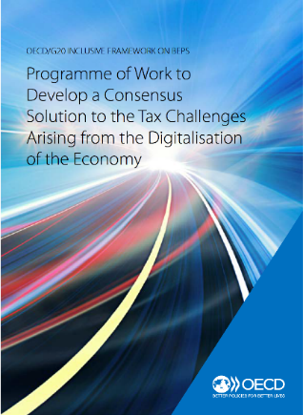
Background
2015
  BEPS Action 1 Report
2018
  March: Interim report
2019
  January: Policy Note
2019
  February/ March: Public consultation
2019
  Programme of Work (PoW) approved by the Inclusive Framework on 28 May 2019
Over 2,000 pages of comments and 400 participants

Slide 3
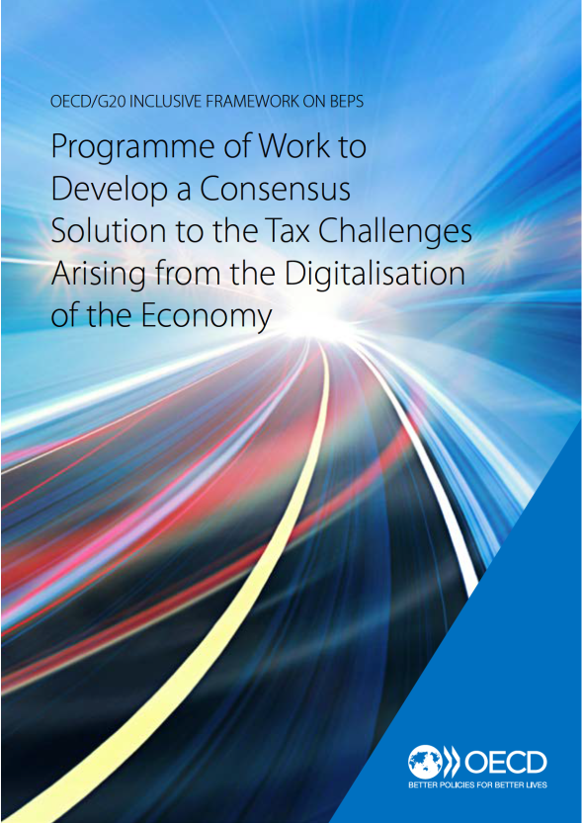
The Programme of Work
Programme of Work elements:
  Pillar 1 (Profit allocation and nexus) alternatives
      User contribution
      Marketing Intangibles
      Significant Economic Presence
  Pillar 2 (Global anti-Base Erosion Proposal)
    Ensuring a minimum level of taxation
  Economic analysis and impact assessment
Develop a consensus solution by end of 2020 in Inclusive Framework on BEPS

Slide 4
PILLAR 1: The secretariat proposal for a unified approach

Slide 5

The challenge
  Aggressive audits & tax disputes
  Unilateral measures
  Dissatisfaction focused on highly digitalized MNEs and allocation of taxing rights
Tensions in the system
Three proposals from IF members
  No single proposal has reached consensus in isolation
  G20 and G7 support
  IF commitment (2018 Interim Report, 2019 PoW)
High level of political commitment

Slide 6
The objective
  Design new “nexus” and “profit allocation” rules unconstrained by physical presence and create appropriate infrastructure to support these rules.
  Ensure the proposal is as least complex as possible and contributes to improve tax certainty for both governments and taxpayers.
  No intention to overhaul conventional transfer pricing (ALP). Instead, objective is to ensure the proposal can co-exist with ALP to avoid double taxation, including by limiting disruptions where the ALP enjoys broad acceptance. increase tax certainty through more effective dispute prevention and binding dispute resolution

Slide 7
Start with the commonalities…
Envisage a new nexus rule that would not depend on physical presence
Reallocate taxing rights in favour of the market/user jurisdiction
Go beyond the ALP in reallocating taxing rights, including departing from the separate-entity principle
Search for simplicity, stabilisation of the tax system and increased tax certainty in implementation

Slide 8
… as the basis of a “Unified Approach”
A – Portion (%) of deemed residual profit
Introduce new nexus
Revise profit allocation rules
B – Fixed return for baseline distribution functions
  Deal with the digitalisation of the economy
  New nexus rule for remote activities
  Increase profit allocated to market jurisdictions
  Avoid distortions
C – Additional return for activities exceeding those covered in Amount B based on TP analysis
https://www.oecd.org/tax/beps/oecd-invites-public-input-on-the-secretariat-proposal-for-a-unified-approach-under-pillar-one.htm
8

Slide 9
PILLAR 2
Global Anti-Base Erosion Proposal

Slide 10
Overview of the GloBE proposal
Income inclusion rule
Switch-over rule
Income inclusion rule
Switch-over rule
Undertaxed payments rule
Subject to tax rule
Income not subject to tax at a minimum rate
Subject to tax rule
Undertaxed payments rule
Public consultation document published in November/ consultation meeting mid-December
https://www.oecd.org/tax/beps/public-consultation-meeting-global-anti-base-erosion-proposal-pillar-two-9-december-2019.htm

Slide 11
More information
Andrew Auerbach
Senior Tax Adviser
OECD Centre for Tax Policy and Administration
andrew.auerbach@oecd.org
WA:+62 (0) 811 192 8946
Tel: +33 (0) 1 45 24 15 06
http://www.oecd.org/tax/
https://twitter.com/OECDtax

